Slide 1
WELCOME TO MY CLASS
English 7 Wed, Sept 20th, 2017
UNIT 3 . COMMUNITY SERVICE
PERIOD 16. LESSON 1. GETTING STARTED
Teacher: Nguyen Thi Thu Ha

Slide 2
1. Hang man:
S
E
R
V
I
C
E
S

Slide 3
1. Hang man:
V
O
L
U
N
T
E
E
R

Slide 4
UNIT 3. COMMUNITY SERVICE
Period 16
GETTING STARTED
A HELPING HAND

Slide 5
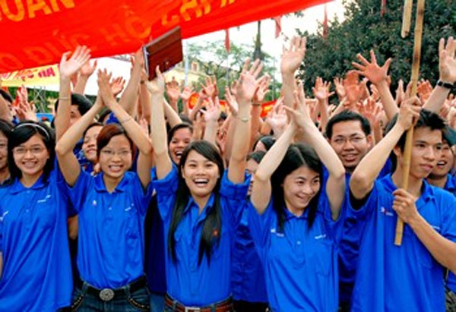
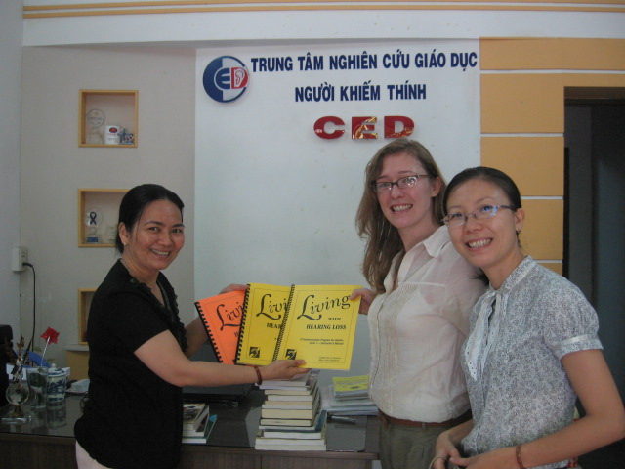
I. New words:
community service /kəˈmjuːnɪti ˈsɜːvɪs/ (n)
: phục vụ cộng đồng
benefit / ˈbenɪfɪt / (n)
: lợi ích
volunteer /ˌvɒlənˈtɪə / (v, n )
: đi tình nguyện
non-profit /nɒn- ˈprɒfɪt/ (adj)
: phi lợi nhuận
donate /dəʊˈneɪt/ (v)
: hiến tặng , đóng góp
to make a difference / meɪk ə ˈdɪfrəns /
: làm thay đổi (cho tốt đẹp)

Slide 6
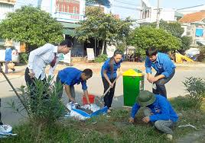
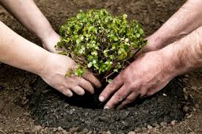
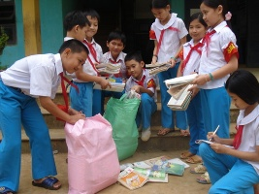
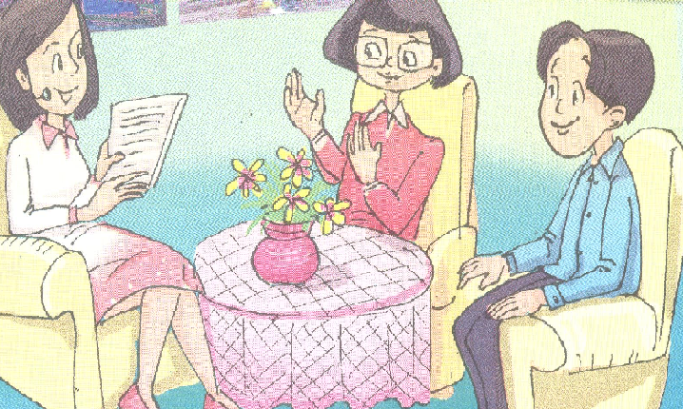
* introduction
mai
reporter
phuc
2. What are they talking about?
1. Who do you think they are ?

Slide 7
II. Listen and read
1. Global citizen
The name of the radio program.
2. Be a Buddy
The organization that Mai is from
3. Go Green
The organization that Phuc is from
4. Hai Ba Trung school
The school where Mai and Phuc go to

Slide 8
1. Read the conversation again and tick T (true) or F (False). (Ex. a/p.27)
1 | Mai and Phuc work for the benefits of the community.
2 | Be a Buddy has collected books and clothes for street children.
3 | Be a Buddy has provided education for street children.
4 | Go Green is an environmental business.
5. | Go Green has encouraged people to recycled rubbish.
T
T
T
F
T

Slide 9
2. Read the conversation again. Answer the following questions. (Ex. b/ p. 27)
1. What does the community service mean?
2. What does the phrase “ make a difference” mean?
3. What does the Go Green do in their community garden project?
4. How does the community garden project do to make a difference”?
5. What does “Be a Buddy” do?

Slide 10
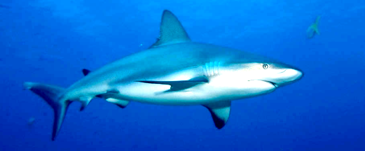
Shark attack
1. What does the community service mean?
Helping the community without payment.
2. What does the phrase
“ make a difference” mean?
Not the same.
3. What does the Go Green do
in their community garden project?
It plants trees.
4. How does the community garden
project do to make a difference”?
To protect the environment.
5. What does “Be a Buddy” do?
To help the street children.

Slide 11
III. PRACTICE
1. Look at the words in the box. Can you put them in the right groups? (Ex. 2/p.27)
donate
help
benefit
help
benefit
volunteer
recycle
environmental
encourage
plant
provide
clean
plant
clean
nouns
verbs
adjectives

Slide 12
2. Fill the gaps with the words in the box.(Ex. 3 /p.27)
donates
volunteer
community service
make a difference
homeless people
1. You are a _______________ if you help other people willingly and without payment.
2. _______________ are those who do not have a home and really need help.
3. She often ________________ money to charitable organisations.
4. The activities that individuals or organisations do to benefit a community are called ______________.
5. If you are trying to _____________________, you are trying to have a good effect on a person or situation.

Slide 13
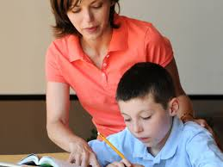
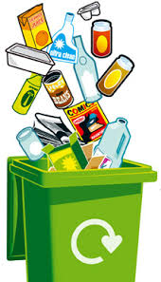
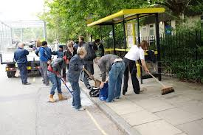
3. Describe the pictures with the verbs in 2. (Ex. 4 / p.27)
Plant
Help
Donate
2. _________ trees
1. ___________ books.
3. __________ children do homework.
4. ______ street.
Clean
Recycle
4. ___________ rubbish

Slide 14
4. Create word webs. (Ex. 5 / p.27)
books
blood
DONATE
clothes
money

Slide 15
4. Create word webs. (Ex. 5 / p.27)
children
HELP
Elderly people
Homeless people
The poor

Slide 16
4. Create word webs. (Ex. 5 / p.27)
street
walls
CLEAN
School yard
beaches

Slide 17
4. Create word webs. (Ex. 5 / p.27)
food
attention
PROVIDE
Life skills
houses

Slide 18
IV. At home
Learn new words by heart.
Do exercises B1, B2 (page 18/ workbook).
Prepare A CLOSER LOOK 1.

